Slide 1
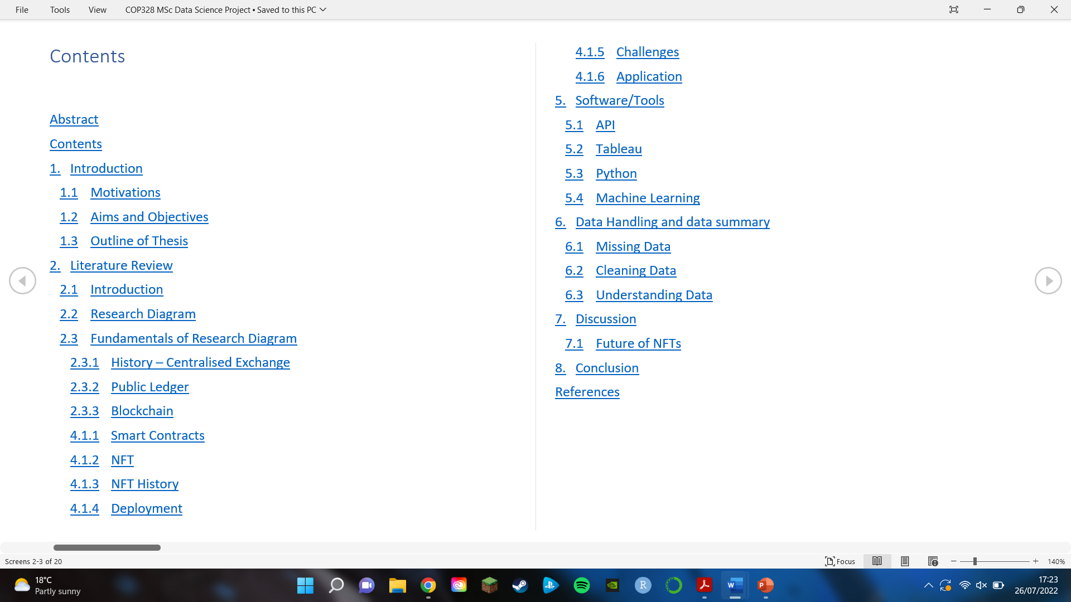
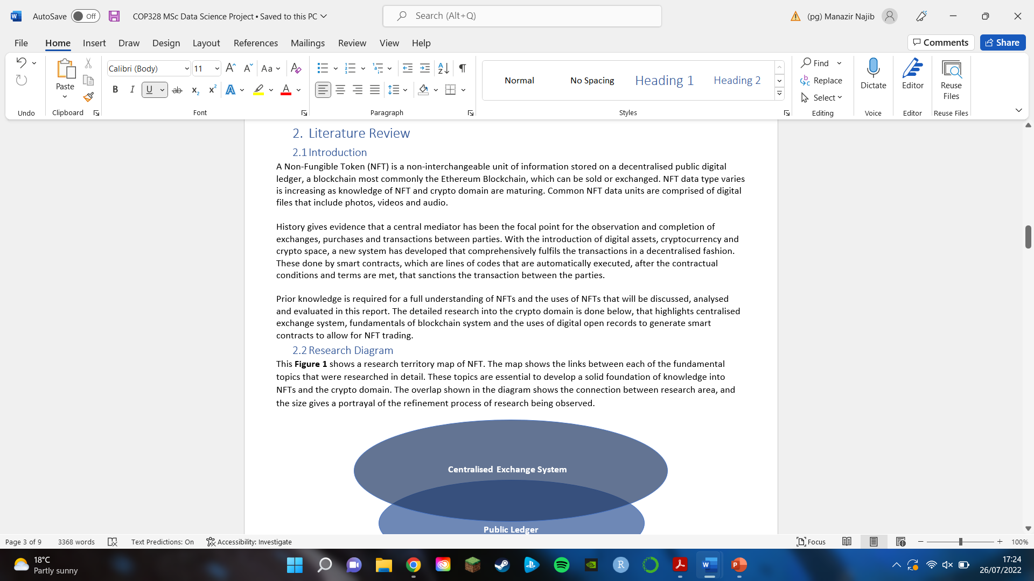
Contents Page – Highlighting Structure of Dissertation

Slide 2
Completed
3000 + Words
Literature Review – from 1st Principle
Discussion on where NFT
Application
Future Prospects
Challenges
Discussion on Tools and Software being used

Slide 3
Data
CryptoPunk NFT
This data set comprises 12000 transactions, each with
information on the Seller and Buyer Addresses, CryptoPunk
ID, CryptoPunk type, Ethereum price, USD price, and
CryptoPunk attributes.

Slide 4
Still need to work on
Analysing Data
Discussion of Data
Programming
Conclusion

